Slide 1

House price prediction
Submitted by:
Vikas Ojha

Slide 2
Conceptual Background and Domain Knowledge
Houses are one of the necessary need of each and every person around the globe and therefore housing and real estate market is one of the markets which is one of the major contributors in the world’s economy .Real estate price prediction is crucial for the establishment of real estate policies and can help real estate owners and agents make informative decisions.
With a large amount of unstructured resources and documents, the Real estate industry has become a highly competitive business.
The data science process in such an industry provides an advantage to the developers by processing those data, forecasting future trends and thus assisting them to make favourable knowledge-driven decisions.
Data science comes as a very important tool to solve problems in the domain to help the companies increase their overall revenue, profits, improving their marketing strategies and focusing on changing trends in house sales and purchases.
The aim of this study is to employ actual transaction data and machine learning models to predict prices of houses.
The actual transaction data contain attributes and transaction prices of real estate that respectively serve as independent variables and dependent variables for machine learning models

Slide 3
Problem Definition
A US-based housing company named Surprise Housing has decided to enter the Australian market. The company uses data analytics to purchase houses at a price below their actual values and flip them at a higher price.
The company is looking at prospective properties to buy houses to enter the market. We are required to build a model using Machine Learning in order to predict the actual value of the prospective properties and decide whether to invest in them or not.
The aim of project is to find out which variables are important to predict the price of houses and how do these variables describe the price of the house .
The goal is to model the price of houses with the available independent variables and understand how exactly the prices vary with the variables and developing a model which not only predicts the sale price of properties for a customer according to his\her interests, but also recognizes the most preferred location of real estate and other utilities and features in any given area.
Further, the model will be a good way for the management to understand the pricing dynamics of a new market and yield high returns.

Slide 4
Dataset Description
Two datasets are being provided to (test.csv, train.csv). We will prepare model from train dataset and predict on test.csv file.
The train dataset has 81 columns and a total of 1168 records (rows).Where there are 80 inputs/features and 1 target column(label) Sale price is our target variable.
The test dataset has 80 columns and a total of 292 records (rows) for which we need to make the predictions.
Data contains Null values in 18 features. Which needs to be treated them using the domain knowledge and own understanding.
Data contains numerical as well as categorical variable.
There are about 9% of outliers in the data.
Most of the columns are categorical in nature.

Slide 5
Data Pre-Processing
Before we feed the data to the model we make sure our data is clean and well structured.
Few pre-processing steps carried out on the dataset are:
Treating Nan values:
Initially we have replaced the nan values to the meaning from description file.
Then we have replaced other columns with mean and median of column.
Label encoding:
The machine learning model can only understand numbers hence we need to convert/encode all the categorical columns into numbers. Label encoder has been used for the same.
Skewness reduction:
As the features had uneven distribution power transformation is used to reduce the skewness. The method used is yeo-Johnson.

Slide 6
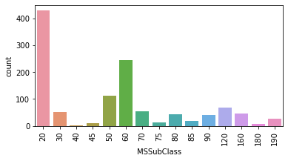
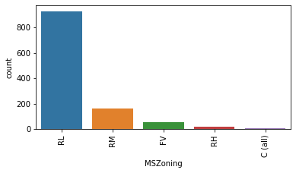
Data Visualization - Univariate Analysis
Observations:
1) There are 428 houses of 1-Story 1946 & newer all style for sale.
2) The second highest sale is of 2-Story 1946 & newer houses. It counts to 244 in number.
3) The lowest number of houses for sale is of 1-story w/finished attic all ages.
Observations:
The houses in Residential Low Density are highest in sale of houses.
2) The houses in Residential Medium Density are second highest in sale of houses.
3) The commercial property houses are least in sale.

Slide 7
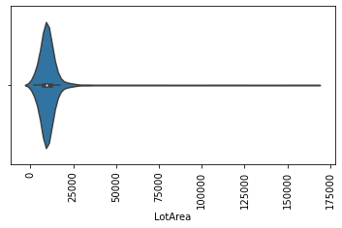
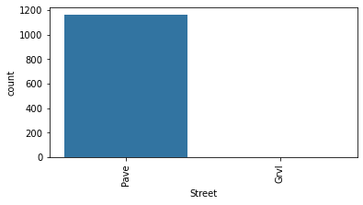
Data Visualization - Univariate Analysis
Observations:
1) Most of the houses have paved street
2) Only 4 houses have gravel street.
Observations:
1) Most of the property have the lot area b/w 9600 and 13000.

Slide 8
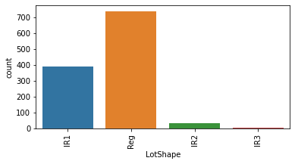
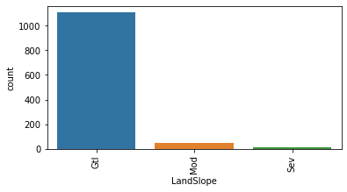
Data Visualization - Univariate Analysis
Observations:
Most of the houses are in regular shape.
Slightly irregular shaped houses are 390 in number. 3) Irregular shaped houses are least in number.
Observations:
1) Most of the houses have gentle slope. They are 1105 in number.
2) second most of the houses have moderate slope. They are 51 in number.
3) There are 12 houses which have severe slope.

Slide 9
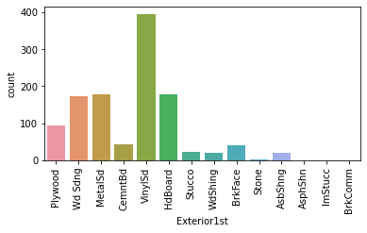
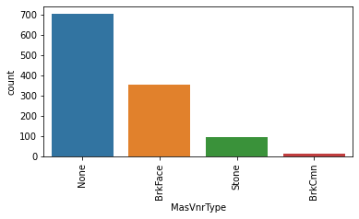
Data Visualization - Univariate Analysis
Observations:
Most of the houses have Exterior covering of Vinyl Siding. They counts 396 in number.
Second most houses have Exterior covering of Hard Board. They counts 179 in number.
Observations:
Most of the houses don't have Masonry veneer type. They counts 703 in number.
Second most houses have Brick Face Masonry veneer type. They counts 354 in number.

Slide 10
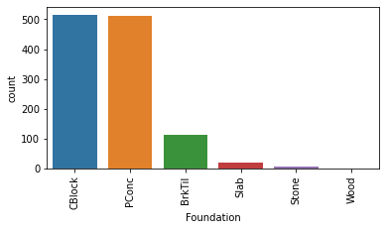
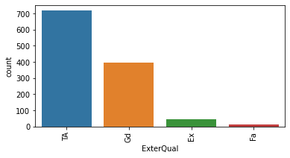
Data Visualization - Univariate Analysis
Observations:
1) Most of the houses have Average/Typical quality of the material on the exterior. They counts 717 in number. 2) Second most houses have Good quality of the material on the exterior. They counts 397 in number.
Observations:
Most of the houses have foundation of Brick & Tile and Cinder Block.
Only one house have the foundation of Wood.

Slide 11
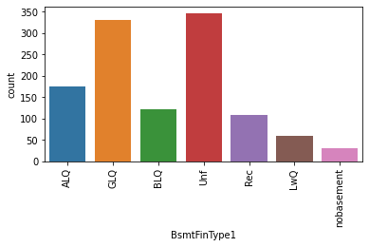
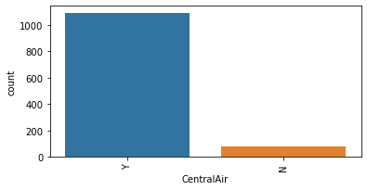
Data Visualization - Univariate Analysis
Observations:
Most of the houses are Unfinshed basement. There are 345 number of houses under this category.
Second most of the houses are Good Living Quarters. There are 330 number of houses in this category.
There are 30 houses with no basement in it.
Observations:
1) There are 1090 houses with Central Air Conditioning system.
2) 78 houses don't have Central Air Conditioning system.

Slide 12
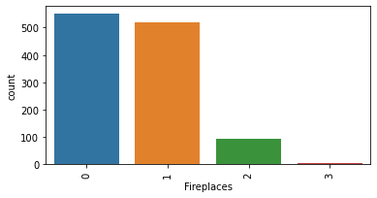
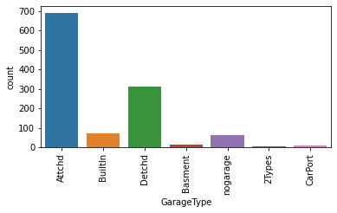
Data Visualization - Univariate Analysis
Observations:
Most of the houses have attached garage. They counts to 691 in number.
The houses with detached from home garage lies on second. There are 314 in number.
There are 5 houses with more than one type of garage.
Observations:
Most of the houses have no fire place. They counts to 551 in number.
The houses with one fire place lies on second. There are 518 in number.
There are 5 houses with 3 fire place.

Slide 13
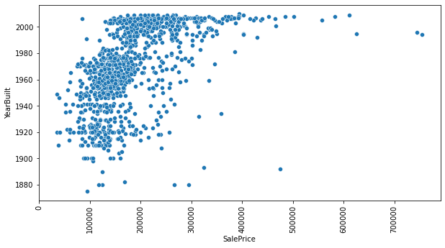
Data Visualization - Bivariate Analysis
Observations:
Most of the property are constructed in between 1950 and 1979.
The prices of houses build in between 1950 and 1979 lies between 100000 to 200000.
Second Most constructed house are in year 1990 and above.
The prices of these houses lies between 150000 to 300000.
Sale Price and Year Built are positively correlated. The sale price of new house are more as compared houses build in 1920's.

Slide 14
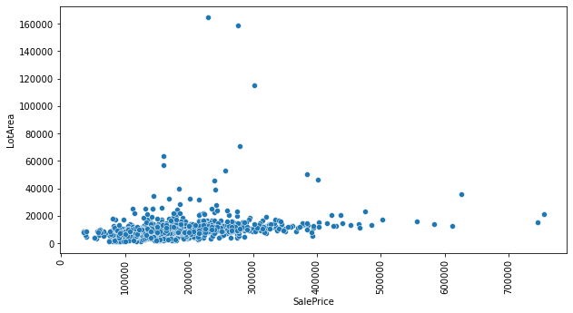
Data Visualization - Bivariate Analysis
Observations:
Most of the property have lot area below 20000.
Prices of these property lies between 80000 to 300000.
Only two property has lot area more than 160000 and their cost is approx 250000 and 300000.
Only two property has price more than 700000 and their cost is approx 745000 and 755000.

Slide 15
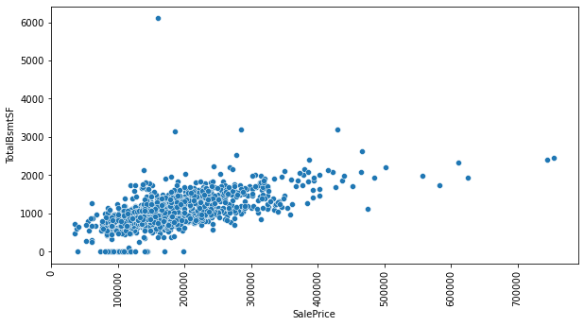
Data Visualization - Bivariate Analysis
Observations:
Most of the property are constructed in between 1950 and 1979.
The prices of houses build in between 1950 and 1979 lies between 100000 to 200000.
Second Most constructed house are in year 1990 and above.
The prices of these houses lies between 150000 to 300000.
Sale Price and Year Built are positively correlated. The sale price of new house are more as compared houses build in 1920's.

Slide 16
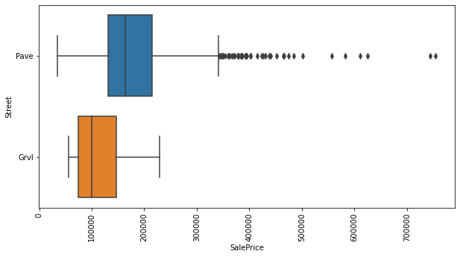
Data Visualization - Bivariate Analysis
Observations:
The property with Paved road access has more Sale Price. It means the property which has good road connectivity have higher sale prices.
Mean price of paved road access is approx 160000.
3) The property with gravel roads have lower sale price.

Slide 17
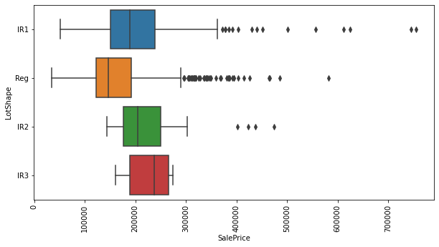
Data Visualization - Bivariate Analysis
Observations:
1) The property with slightly irregular shape has higher sale price. Maximum Price is 380000.
2) The price of slightly irregular shape starts with approx 50000.
3) Regular Shape property starts with the price of approx 35000 and maximum price is approx 600000.
4) Irregular shaped property has the least Sale Price. Min sale price is approx 160000 and Maximum is approx 280000.

Slide 18
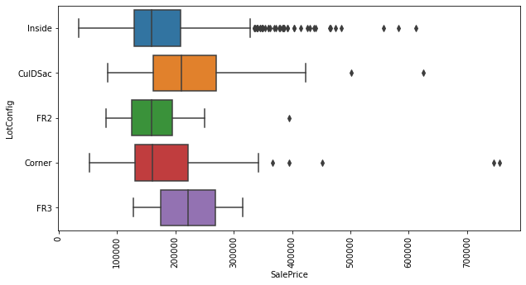
Data Visualization - Bivariate Analysis
Observations:
Cul-de-sac has the highest Sale Price.
Frontage on 2 sides of property has the lowest Sale Price.

Slide 19
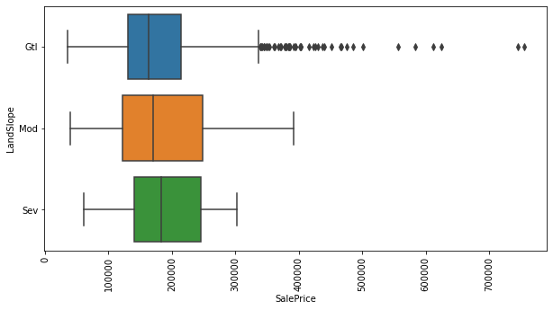
Data Visualization - Bivariate Analysis
Observations:
The property with moderate slope has the highest sale price. Maximum Sale price is 400000.
Second highest Sale Price is of Gentle Slope.
Lowest Sale Report is of Severe Slope.

Slide 20
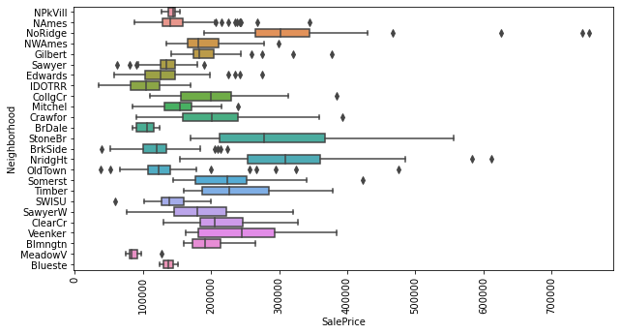
Data Visualization - Bivariate Analysis
Observations:
The property near Stone Brook has the highest Sale Price. Maximum Sale Price is 570000.
Second highest sale price is of Northridge Heights which has max sale price of approx 500000.
Third highest Sale price is of Northridge whic has the max price of 430000.
Lowest sale price is of Meadow Village. Max sale price is 100000.

Slide 21
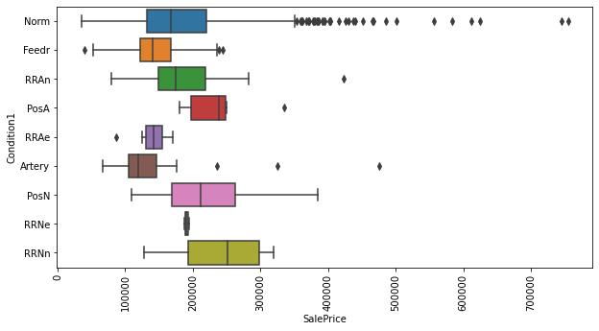
Data Visualization - Bivariate Analysis
Observations:
The area near positive off-site feature--park, greenbelt, etc. has the maximum sale price of approx 400000.
The area near normal land, has the second highest sale price.
The area adjacent to East-West Railroad has the lowest sale price.

Slide 22
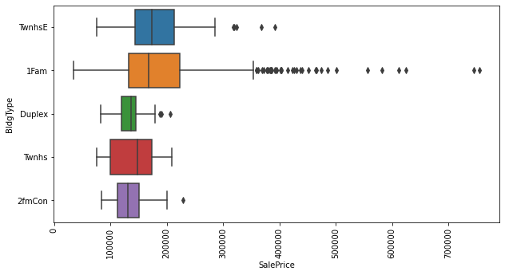
Data Visualization - Bivariate Analysis
Observations:
The dwelling with Single family detached has the highest sale price.
Townhouse Inside Unit has the second highest sale price.
Duplex dwelling has the lowest sale price. Its maximum sale price is 180000.

Slide 23
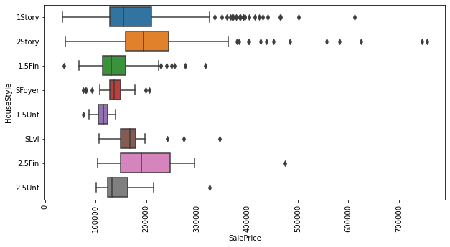
Data Visualization - Bivariate Analysis
Observations:
The houses with two story has the highest sale price of max 360000.
Second highest sale price is of single story which has the max sale price of 320000.
Lowest sale price is of One and one-half story: 2nd level unfinished.

Slide 24
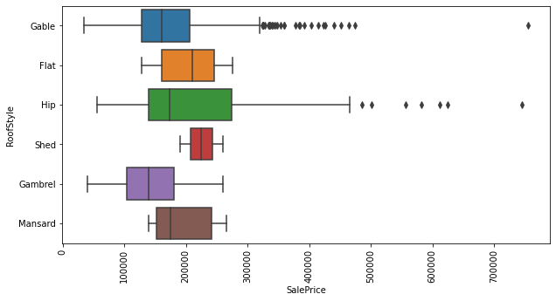
Data Visualization - Bivariate Analysis
Observations:
The roof with hip has the highest Sale Price. It has the maximum sale price of 460000.
The roof with gabble has the second highest sale price. It has the maximum sale price of 320000.
The roof with shed and Gambrel has the lowest sale price.

Slide 25
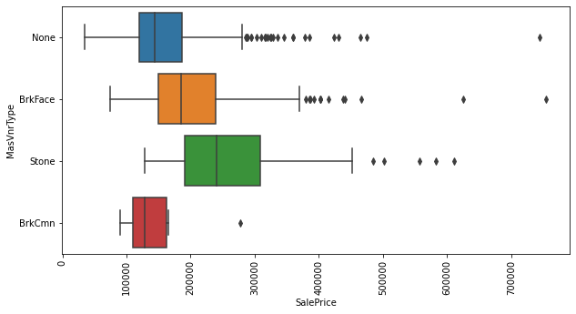
Data Visualization - Bivariate Analysis
Observations:
The houses with stone Masonry veneer type have the highest sale price.
The houses with Brick Common Masonry veneer type have the lowest sale price.

Slide 26
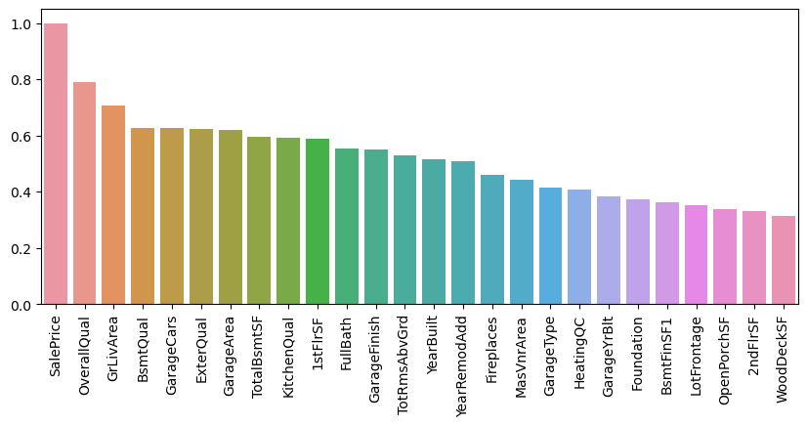
Correlation Coefficient between inputs and output

Slide 27
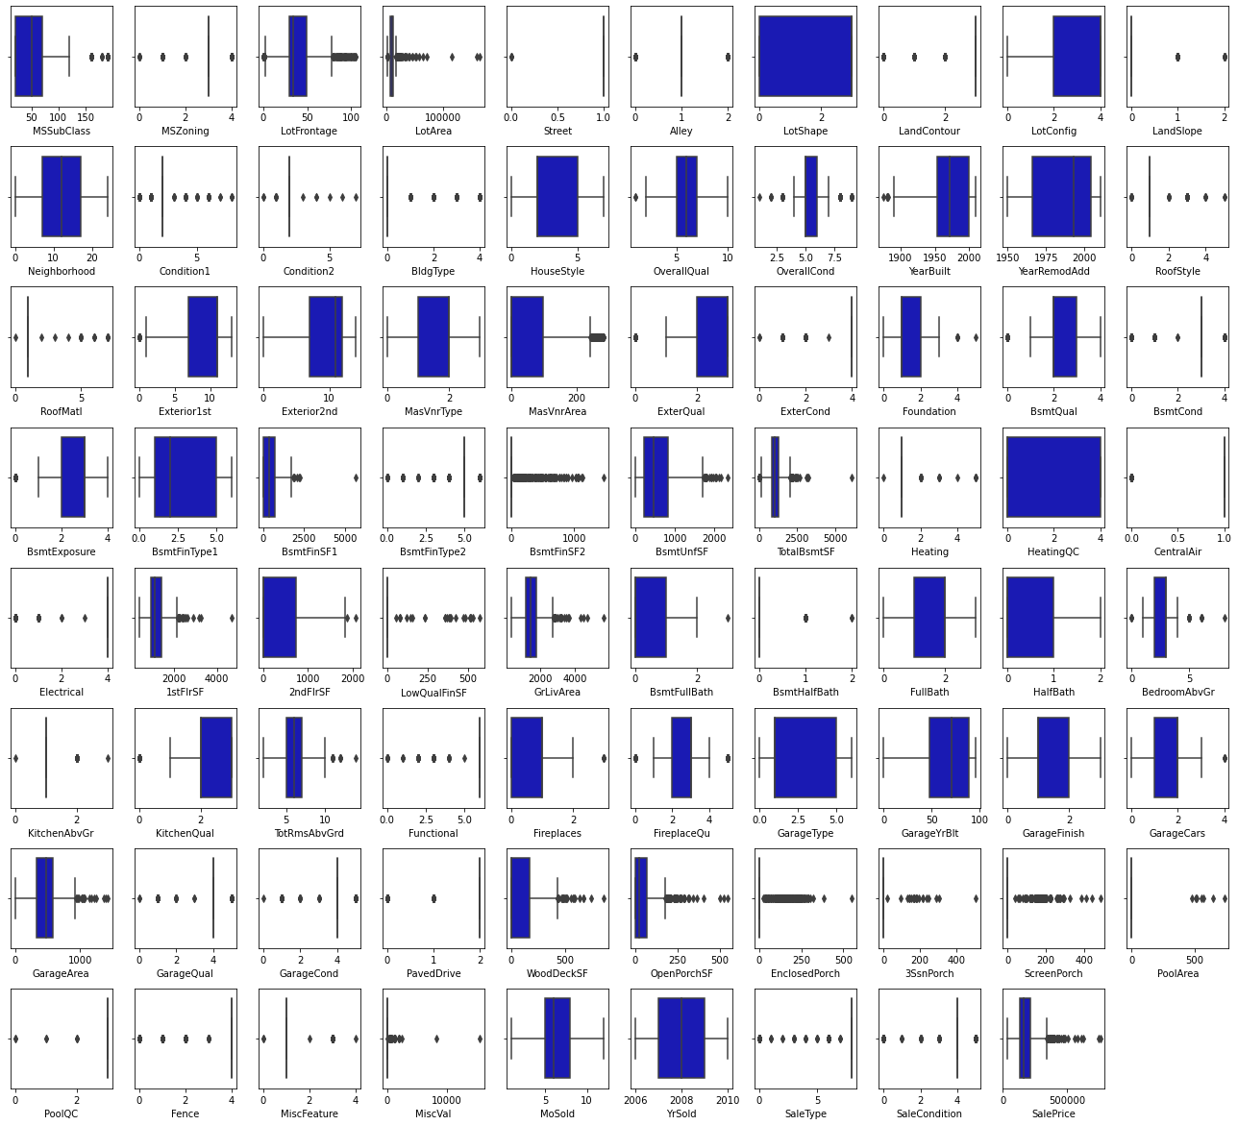
Box plots to visualise outliers

Slide 28
Statistical and Descriptive analysis
Statistics and probability can be used to figure out trends in data set.
ds.corr() is used to determine the correlation between features and target variable.
The zscores are calculated in order to determine the outliers present in the dataset.
Zscores>3 are treated as outliers
ds.desrcibe() is used to view the mean, median and various percentiles of the features.
To sum up all, Exploratory Data Analysis is a philosophical and an artistic approach to gauge every nuance from the data at early encounter.

Slide 29
Concluding Remarks for EDA
The standard deviation are high
Few Features posses skewness.
The amount of data where z-scores are greater than 3 accounts to 9% which would result in data loss if the records are dropped
There are 18 features with Nan values which we have imputed using mean and mode.
Out of 80 features many of them are irrelevant with respect to the target i.e. sale price.
We have decided on the most relevant features by finding correlation between the input variable and target.

Slide 30
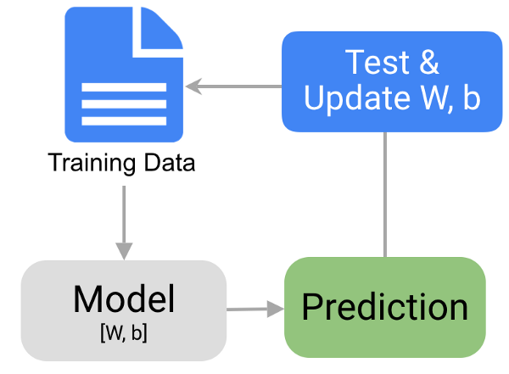
Model Building
The process involves training a model over a set of data, providing it an algorithm that it can use to reason over and learn from those data.
As the target variable is continuous it is a regression problem.
The steps involved in model building are as follows:
Assign input/features and output/target to different variables.
Split the data into train and test dataset.
Train the model on the data provided
Test the model using various evaluation metrics
Use the trained model to make predictions
Save the trained model for future use.

Slide 31
Algorithms and Evaluation Metrics used
Algorithms used
Linear regression
Decision Tree regression
KNN Regression
Random Forest Regression
Evaluations metrics used
R2 scores
Cross validation scores
Mean absolute error
Mean squared error
Root mean squared error

Slide 32
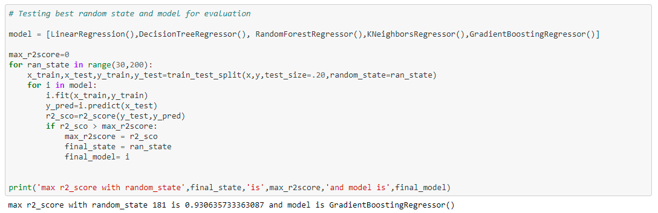
Finding best Random State

Slide 33
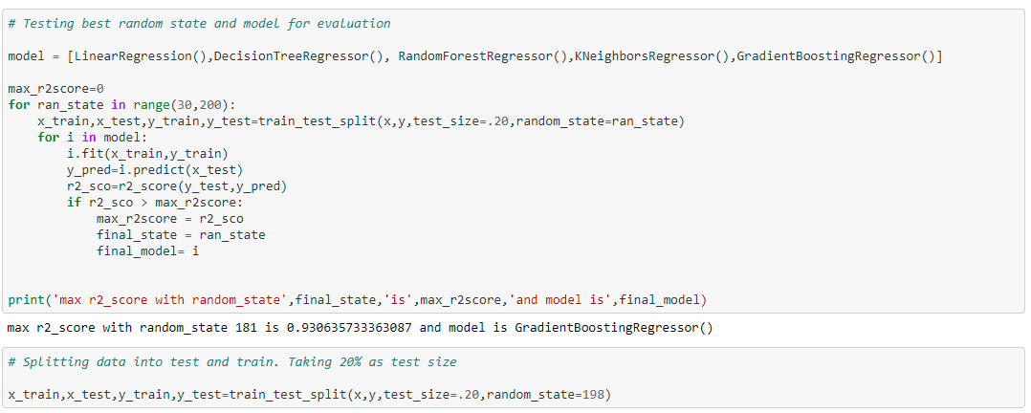
Finding best Random State

Slide 34
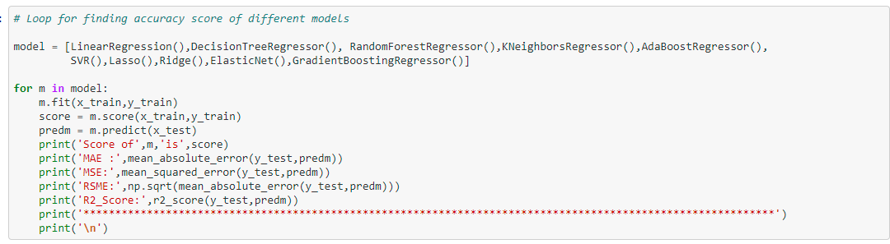
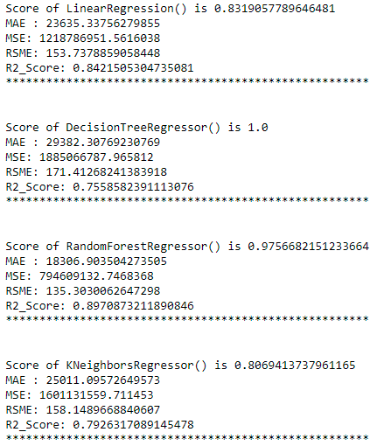
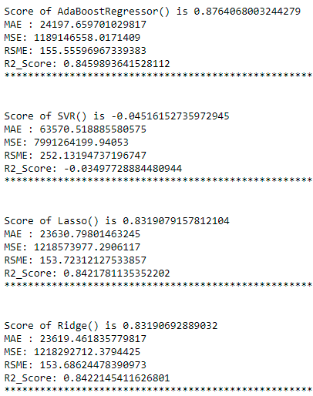
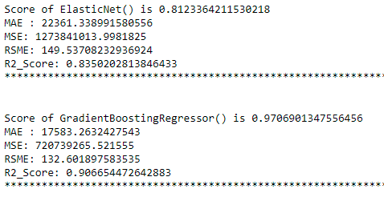
Checking best model with highest score

Slide 35
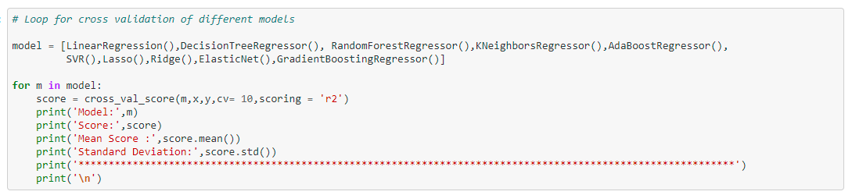
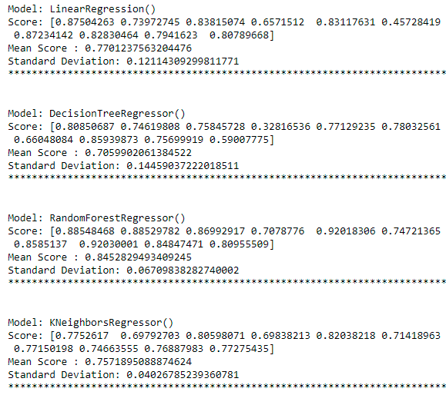
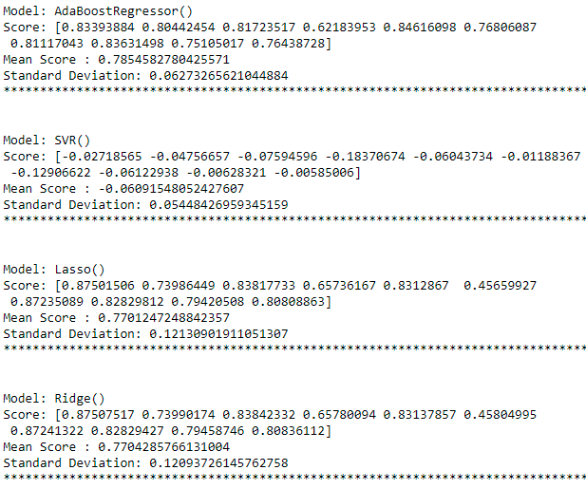
Cross Validation of different Models

Slide 36
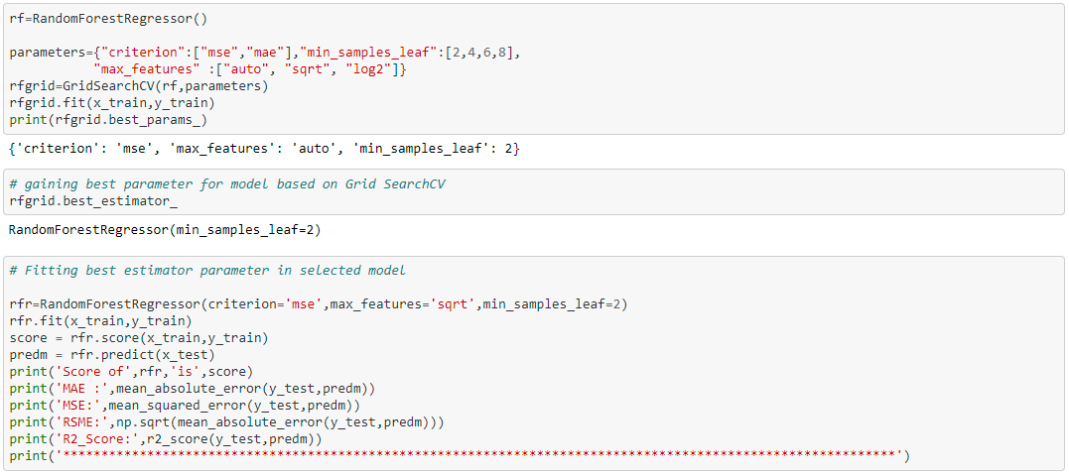
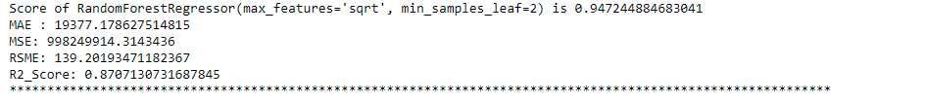
Hyper tuning of Decision Tree Regression
The decision tree is a sort of algorithm that requires a label for functioning, and hence they come under supervised learning. The main aim to use the Decision Tree algorithm involves creating a training model used for predicting the target variable’s class or value by studying easy decision order.

Slide 37
Evaluation metrics
The objective of Regression is to find a line that minimizes the prediction error of all the data points. The essential step in any machine learning model is to evaluate the accuracy of the model.
To evaluate the performance of the model in regression analysis the following are used:
The Mean Squared Error,
Mean absolute error,
Root Mean Squared Error
R-Squared or Coefficient of determination

Slide 38
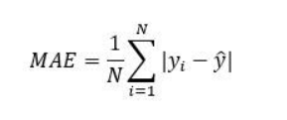
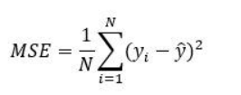
The Mean Absolute Error and mean squared error
The Mean absolute error represents the average of the absolute difference between the actual and predicted values in the dataset. It measures the average of the residuals in the dataset.
Mean Squared Error represents the average of the squared difference between the original and predicted values in the data set. It measures the variance of the residuals.

Slide 39
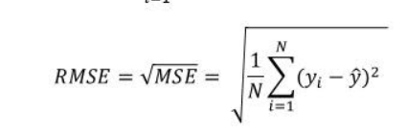
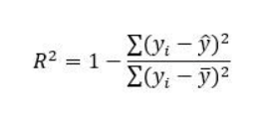
Root mean squared error (RMSE) and R2 Score
Root Mean Squared Error is the square root of Mean Squared error. It measures the standard deviation of residuals.
The coefficient of determination or R-squared represents the proportion of the variance in the dependent variable which is explained by the linear regression model. It is a scale-free score i.e. irrespective of the values being small or large, the value of R square will be less than one.

Slide 40
Conclusion
Mean Squared Error computes the difference between the mean squared of the predicted values and the actual values; Root Mean Square Error computes the square root of the Mean Squared Error.
RMSE is applied to all the four algorithms. R squared or the coefficient of determination is the measure of the closeness of predicted data with the actual data.
With all the comparison metrics, it is observed that Random Forest Regression shows the least Root Mean Square Error with a value . Therefore, there are fewer errors in this metric as compared to others.
Mean Squared Error is also lowest for the Random Forest Regression algorithm with the value.
The other evaluation metric used, Mean absolute Error also gives the least value with Random Forest.

Slide 41
Conclusion
Real estate prices vary due to a wide variety of attributes. The machine learning-based model is a substantial and feasible way to forecast real estate prices, and can provide relatively competitive and satisfactory results.
Features that greatly contribute to house price predictions were locality (neighbourhood) ,above grade living area ,parking capacity of the properties, Basement area and area above grade, facilities like electricity, water, gas septic tanks, fire place, number of full and half baths, the year of construction, Overall quality of the house including exterior and material quality.
Few features like MS Zone, Miscellaneous features, land slope, month in which property was sold, and etc. did not make any significant impact on the prediction of sale prices.
Thus Machine learning models, including linear regression, KNN regression, decision tree regression and random forest regression, were used in this investigation to forecast house prices.

Slide 42
References
Fik T J, Ling D C and Mulligan G F 2003 Modeling spatial variation in housing prices: a variable interaction approach. Real Estate Economics, 31(4), 623-46.
Varma A, Sarma A, Doshi S and Nair R 2018 House Price Prediction Using Machine Learning and Neural Networks. In 2018 Second International Conference on Inventive Communication and Computational Technologies (ICICCT) 1936-39. IEEE.
Bhagat N, Mohokar A and Mane S 2016 House price forecasting using data mining. International Journal of Computer Applications, 152(2), 23-26.
Amri S and Tularam G A 2012 Performance of multiple linear regression and nonlinear neural networks and fuzzy logic techniques in modelling house prices. Journal of Mathematics and Statistics, 8(4), 419-434.
Vineeth N, Ayyappa M and Bharathi B 2018 House Price Prediction Using Machine Learning Algorithms. In International Conference on Soft Computing Systems, 425-33.
Alfiyatin A N, Febrita R E, Taufiq H and Mahmudy W F 2017 Modeling house price prediction using regression analysis and particle swarm optimization. International Journal of Advanced Computer Science and Applications, 8.
Afonso B, Melo L, Oliveira W, Sousa S and Berton L 2019 Housing Prices Prediction with a Deep Learning and Random Forest Ensemble. In Anais do XVI Encontro Nacional de Inteligência Artificial e Computacional 389-400. SBC.
McKinsey & Company 2018|Article Getting ahead of the market: How big data is transforming real estate.

Slide 43
THANK YOU

